Slide 1
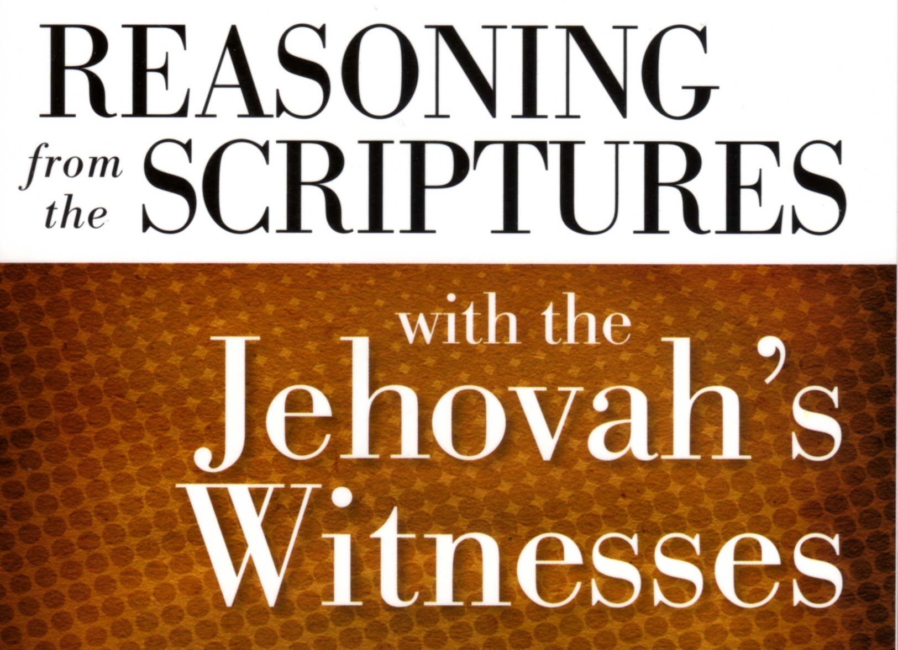

Slide 2
Revelation 7:1-8
¹ After this I saw four angels standing at the four corners of the earth, holding back the four winds of the earth, that no wind might blow on earth or sea or against any tree. ² Then I saw another angel ascending from the rising of the sun, with the seal of the living God, and he called with a loud voice to the four angels who had been given power to harm earth and sea, ³ saying, “Do not harm the earth or the sea or the trees, until we have sealed the servants of our God on their foreheads.” ⁴ And I heard the number of the sealed, 144,000, sealed from every tribe of the sons of Israel:
⁵ 12,000 from the tribe of Judah were sealed, 12,000 from the tribe of Reuben, 12,000 from the tribe of Gad, ⁶ 12,000 from the tribe of Asher, 12,000 from the tribe of Naphtali, 12,000 from the tribe of Manasseh, ⁷ 12,000 from the tribe of Simeon, 12,000 from the tribe of Levi, 12,000 from the tribe of Issachar, ⁸ 12,000 from the tribe of Zebulun, 12,000 from the tribe of Joseph, 12,000 from the tribe of Benjamin were sealed.

Slide 3
Revelation 14:1-5
¹ Then I looked, and behold, on Mount Zion stood the Lamb, and with him 144,000 who had his name and his Father's name written on their foreheads. ² And I heard a voice from heaven like the roar of many waters and like the sound of loud thunder. The voice I heard was like the sound of harpists playing on their harps, ³ and they were singing a new song before the throne and before the four living creatures and before the elders. No one could learn that song except the 144,000 who had been redeemed from the earth. ⁴ It is these who have not defiled themselves with women, for they are virgins. It is these who follow the Lamb wherever he goes. These have been redeemed from mankind as firstfruits for God and the Lamb, ⁵ and in their mouth no lie was found, for they are blameless.

Slide 4
Luke 12:32
Fear not, little flock, for it is your Father's good pleasure to give you the kingdom.
John 10:16
And I have other sheep that are not of this fold. I must bring them also, and they will listen to my voice. So there will be one flock, one shepherd.

Slide 5
Luke 12:22
And he said to his disciples, […]
Matthew 10:16
Behold, I am sending you out as sheep in the midst of wolves, so be wise as serpents and innocent as doves.
Matthew 26:31
Then Jesus said to them, “You will all fall away because of me this night. For it is written, ‘I will strike the shepherd, and the sheep of the flock will be scattered.’”
Matthew 10:5-6
⁵ These twelve Jesus sent out, instructing them, “Go nowhere among the Gentiles and enter no town of the Samaritans, ⁶ but go rather to the lost sheep of the house of Israel.”

Slide 6
Salvation
Salvation is impossible without total obedience to Watchtower and thorough participation in the various programs prescribed by the Society.
You cannot know for sure if you have salvation during this life. Only a constant unbending stance against sin and total obedience to God (through WS) gives you any hope of salvation. Even then, if you should fail during the future millennium, you will be annihilated. However, if you faithfully serve God throughout the millennium, you may finally be “declared righteous” and eternal life may finally be granted.
Christ’s sacrifice (on a stake, not a cross) was not for your salvation, but only to “atone” for the sin of fallen man (Adam), in order to make things “even” and give you a fighting chance to earn salvation.

Slide 7
John 3:15
that whoever believes in him may have eternal life.
John 5:24
Truly, truly, I say to you, whoever hears my word and believes him who sent me has eternal life. He does not come into judgment, but has passed from death to life.
John 11:25
Jesus said to her, “I am the resurrection and the life. Whoever believes in me, though he die, yet shall he live.”
John 12:46
I have come into the world as light, so that whoever believes in me may not remain in darkness.
John 20:31
but these are written so that you may believe that Jesus is the Christ, the Son of God, and that by believing you may have life in his name.

Slide 8
The Soul and Hell
The soul is comprised of both body and breath (or life force)
The soul cannot survive apart from the body
Hell is just a common grave for all of mankind
You are not conscious nor aware of anything while dead (in Hell) until the future resurrection (for the righteous)

Slide 9
Matthew 10:28
And do not fear those who kill the body but cannot kill the soul. Rather fear him who can destroy both soul and body in hell.
Revelation 6:9-10
⁹ When he opened the fifth seal, I saw under the altar the souls of those who had been slain for the word of God and for the witness they had borne. ¹⁰ They cried out with a loud voice, “O Sovereign Lord, holy and true, how long before you will judge and avenge our blood on those who dwell on the earth?”
Luke 23:46
Then Jesus, calling out with a loud voice, said, “Father, into your hands I commit my spirit!” And having said this he breathed his last.
Acts 7:59
And as they were stoning Stephen, he called out, “Lord Jesus, receive my spirit.”
Luke 20:38
Now he is not God of the dead, but of the living, for all live to him.

Slide 10
Other Beliefs
Blood transfusions are forbidden (but since May 2000 they are “forgivable”
You are not to celebrate birthdays. Even sending a birthday card is punishable.
Wearing crosses is forbidden. Jesus was not crucified on a cross. Wearing a cross is a form of idolatry.

